Slide 1
Bike Analytics Decentraland Foundation

Slide 2
Challenge
The Buenos Aires bicycle company is targeting to increase bike ride adoption this year. To achieve this, improving bike availability at stations is essential. In this analysis, we extract key insights from the data to support strategic decisions aimed at meeting this business goal.

Slide 3
Table of contents
1
1
1
2
3
4
5
Trending Stations
Start vs. Finish Trends
Popular Timeframes
Average Weekly Rides
Bike Redistribution
1
1
6
7
8
9
10
Ride
Duration
Mechanical Service
Additional Analysis
Data Model Improvement
Feature Suggestion

Slide 4
1
Trending Stations

Slide 5
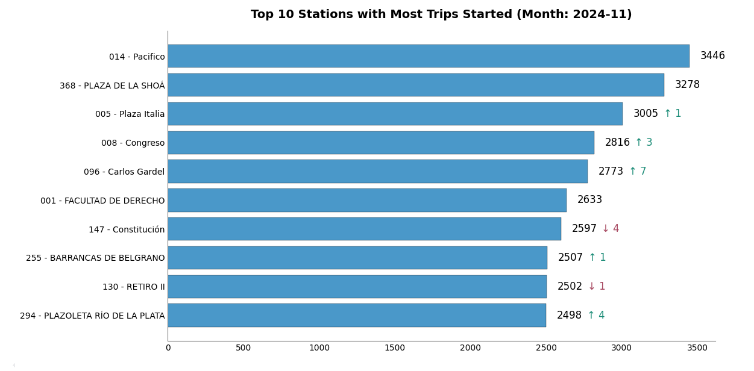
Trending Stations
Overall, the top stations show relatively stable demand, with only moderate fluctuations in rank changes. While 014 - Pacífico continues to lead, other stations—like 288 - Plaza de la Shoa and 005 - Plaza Italia—remain close contenders, indicating steady usage patterns across high-demand areas.

Slide 6
2
Start vs. Finish Trends

Slide 7
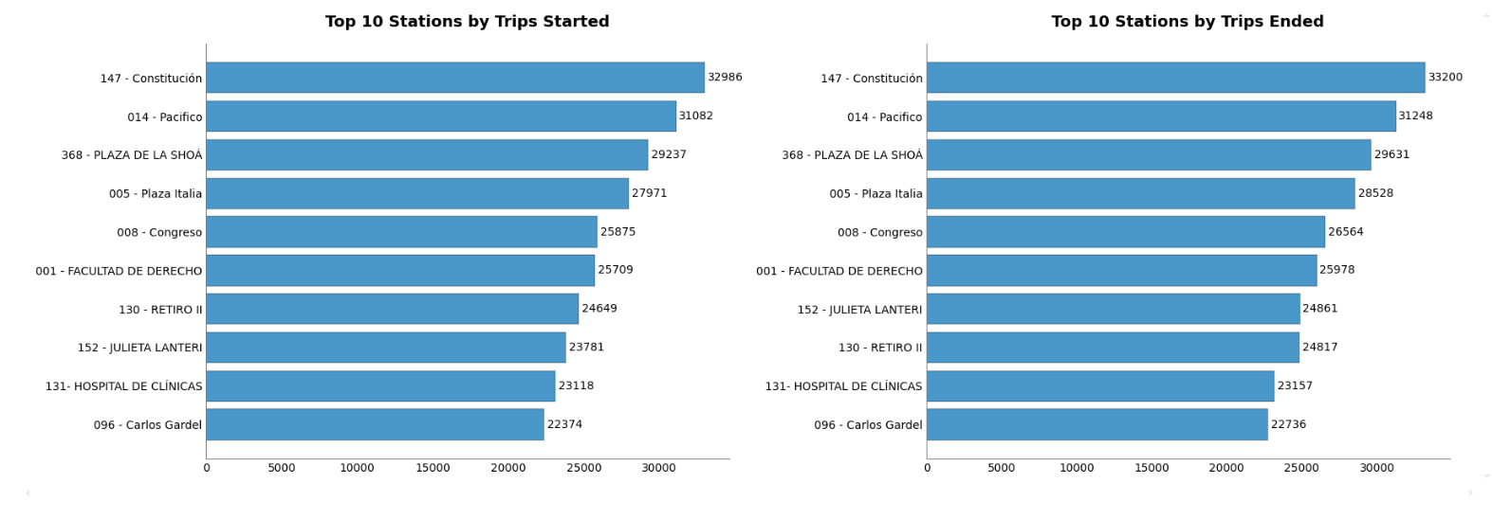
Start vs. Finish Trends
We can see that the same stations dominate both trip origins and trip destinations, suggesting there is no significant change in the list of high-traffic stations when distinguishing between starting and ending points. This consistency points to a robust demand for these specific locations, possibly due to their centrality, transit connections, or proximity to major points of interest.

Slide 8
3
Popular timeframes

Slide 9
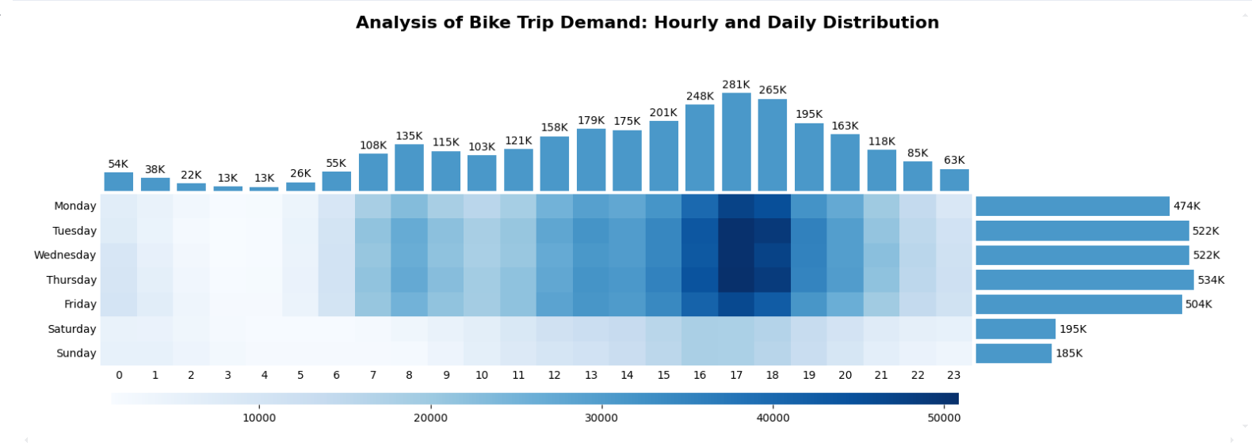
Popular Timeframes
This chart shows that bike trip demand peaks late in the afternoon (roughly 4–8 PM), with Friday having the highest total number of trips among weekdays. Early morning hours (around 7–9 AM) also see increased activity on weekdays, suggesting a strong commuter pattern. Meanwhile, weekend totals are lower, indicating fewer rides overall on Saturdays and Sundays. The visual highlights a clear weekday vs. weekend difference, with demand heavily concentrated around typical commute times during the workweek.

Slide 10
4
Average Weekly Rides

Slide 11
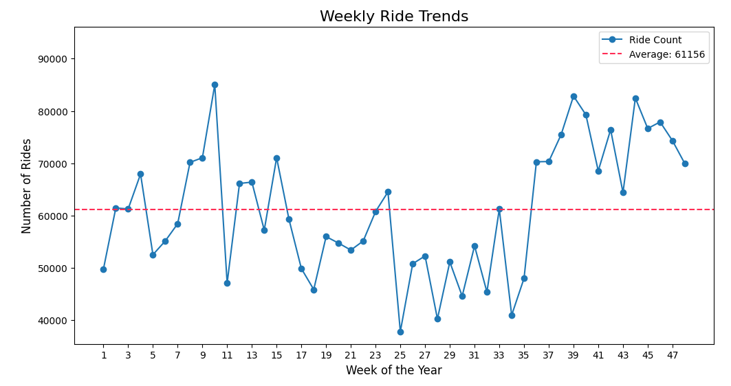
Average Weekly Rides
The trend shows a fluctuating weekly ride count, with an overall average of around 61,156 rides per week. Early in the year, rides hover around or below the average, punctuated by a spike around weeks 7–8. In the mid-year period, there is a notable upswing, especially around weeks 25–28, indicating higher demand. The year’s second half mostly stays above the average, peaking again around weeks 40–41 before dipping slightly. These trends suggest seasonality or external factors like weather, events, etc., influencing ridership, with consistently higher demand in the latter part of the year.

Slide 12
5
Bike redistribution

Slide 13
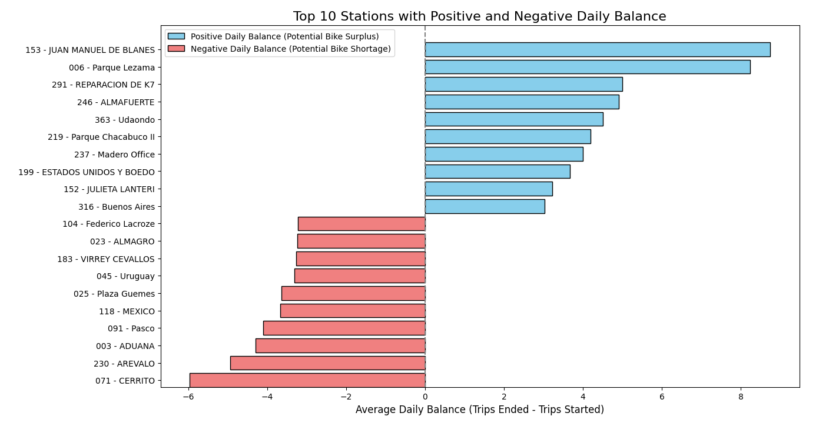
Average Weekly Rides
By transferring bikes from stations with a consistent surplus to those with a shortage, the system can better balance supply and demand. This strategic redistribution not only optimizes operational efficiency but also enhances the user experience by reducing the likelihood of empty docks in high-demand areas and preventing the clogging of stations with excess bikes

Slide 14
6
Ride Duration

Slide 15
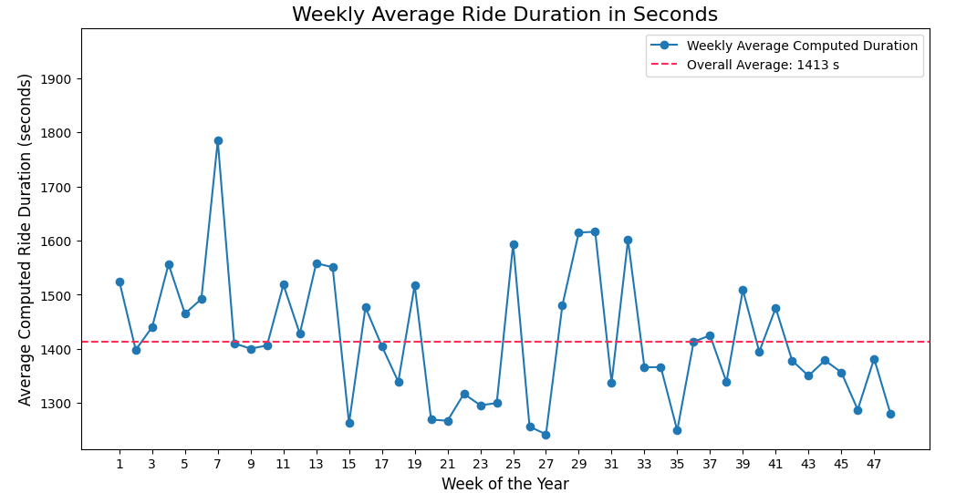
Ride Duration
Ride durations exhibit a seasonal pattern, peaking in the summer months and dropping during the winter. However, this is only one perspective. Extending the analysis to include additional variables such as weather conditions, or user demographics, could offer deeper insights into the factors influencing ride duration and help confirm whether seasonality is the primary driver.

Slide 16
7
Mechanical Service

Slide 17
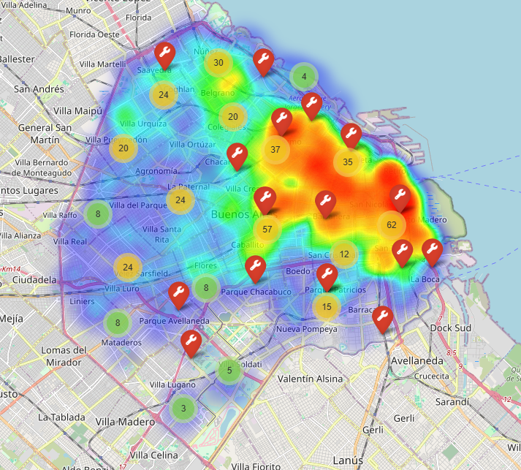
Mechanical Service
From the generated heat map of Buenos Aires, where the hottest zones indicate the highest activity, we can see strong concentrations in the northeast part of the city. In particular, the areas around Facultad de Medicina and Retiro show significant movement but lack nearby mechanical service points.

Slide 18
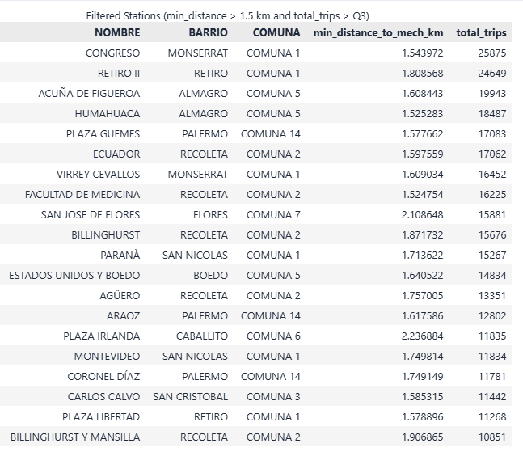
Mechanical Service - Proposal
By performing distance calculations that include only stations located more than 1.5 km from their nearest mechanical point, and then further narrowing the focus to stations whose total trips exceed the 75th percentile, we propose establishing new mechanical points in the Retiro area (Closest Stations: RETIRO I, RETIRO II, and AV. DEL LIBERTADOR) and near Facultad de Medicina (Closest Stations: Ecuador, HOSPITAL DE CLÍNICAS, and Facultad de Medicina). This approach aims to reduce the distance to mechanical services in these high-activity zones, thereby improving service availability and overall system efficiency.

Slide 19
8
Additional Analysis

Slide 20
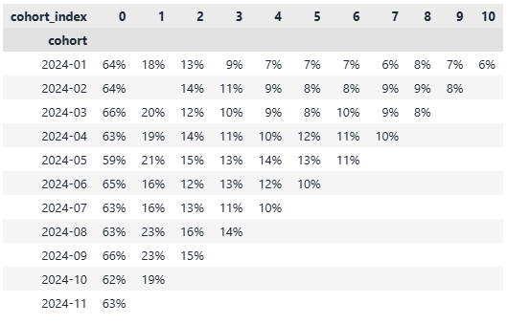
Additional Analysis - Retention
The retention matrix indicates that in the registration month (Month 0), only about 60–66% of users are active by making at least one trip. This suggests that a significant portion, roughly one-third, of new users do not engage with the service immediately upon registration, highlighting a potential area for improvement in the initial onboarding and activation process. Moreover, user activity declines significantly in the months following registration, which strongly suggests the need to implement retention campaigns aimed at keeping these users engaged after their initial activation.

Slide 21
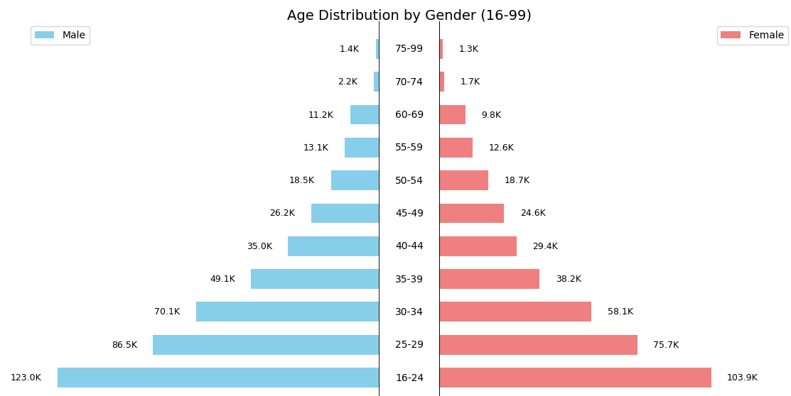
Additional Analysis – Age Distribution
The analysis shows that while the service is predominantly used by younger riders, there is a clear opportunity to boost adoption among older users. Proposed actions include Tailored Engagement for Older Users and Retention and Growth Among Younger Segments.

Slide 22
9
Data Model Improvement

Slide 23
Data Model Improvement
Total Station Capacity Field: Introduce a field to record each station's total capacity (number of docks), enabling accurate assessment of station performance by comparing current availability against maximum capacity to identify over- or under-utilized locations.
Tracking Redistribution Movements: Implement detailed logging of bike redistribution events, including timestamps, origin and destination stations, quantity of bikes moved, and contextual details, to support data-driven rebalancing strategies.
Detailed Individual Bike Information: Collect granular data for each bike (unique identifier, model, maintenance history, usage frequency, and mileage) to facilitate proactive maintenance and optimize fleet management.

Slide 24
KPIs Suggestion
To help achieve an 18% increase, several KPIs can be tracked to provide a comprehensive view of user engagement and retention. For example, monitoring monthly and cohort retention rates will reveal the percentage of users who remain active over time, while tracking churn rate will help identify the rate at which users drop off. Other important KPIs include daily and weekly active users, which reflect overall engagement, and session metrics like frequency and duration that indicate how often and how deeply users interact with the service. Lastly, financial metrics such as customer lifetime value and average revenue per user ensure that improvements in retention are translating into tangible business value. These KPIs together can inform targeted strategies to boost user engagement and retention, thereby supporting the 18% increase goal.

Slide 25
10
Feature Suggestion

Slide 26
Feature Suggestions
Estimated Wait Time:
Predicts how long a user might need to wait for a bike to become available at a station. This estimation would be based on historical data, including time-of-day, day-of-week, and past bike availability trends, thereby helping users plan their trips more efficiently and enhancing overall satisfaction with the bike-sharing service.
Bike Reservation:
Introduce a premium plan that allows users to reserve a bike for a short period, such as 10 minutes, ensuring bike availability when needed. This reservation system would enhance user convenience, reduce uncertainty at high-demand stations, and drive increased revenue through a subscription model.
Waze Integration:
Integrate the app with Waze to provide users with optimal route recommendations based on real-time traffic conditions. This feature would dynamically adjust suggested bike routes and travel times, ensuring smoother and faster trips by avoiding congested areas.

Slide 27
Proposed Data to be tracked
Real-Time GPS Tracking: Record each bike's GPS coordinates with precise timestamps to reconstruct full routes, analyze usage patterns, and calculate speeds and travel times.
Station Capacity Field: Introducing a field that records the total capacity for each bike station would enable a more accurate assessment of station performance by comparing current bike availability against maximum capacity. This helps identify stations that are either operating at full capacity or frequently underutilized, allowing for more effective redistribution strategies and improved service reliability.
Transactional Data Tracking for Bike Redistribution: Implement a system that records all transactional details of bike redistribution events, including timestamps, origin and destination stations, the number of bikes moved, and contextual information such as the reason for the move. Unifying this data facilitates comprehensive analysis of redistribution operations, enabling data-driven optimization of rebalancing strategies and ensuring operational decisions are well-informed by historical trends.
Bike-Level Information: Detailed individual bike information is crucial for enhancing system performance and reliability. Recording each bike's unique identifier and model allows operators to monitor usage patterns and compare performance across models. Additionally, tracking maintenance and service history, along with usage frequency and mileage, enables proactive scheduling of repairs and replacements, ensuring that overused bikes receive timely attention and underused ones are reallocated as needed.

Slide 28
Thanks!

